Slide 1

Database Lecture 3
Entity-Relationship Model, Constraints
Addendum
Dr. Jefferson Fong

Slide 2
Exercise Solutions
Lecture exercises solutions are in the following week’s lecture notes.
Lab exercises solutions are in iSpace beneath the lab submission links, available after the submission deadline for that lab.

Slide 3

Reference: [6.4 Mapping Cardinalities]
Slide 5
“One student can have many majors”; not allowed in UIC
  So we don’t model that in our database.
“One program can have many students”, and “many students can be in one program”
Slide 6
In many-to-one and one-to-many cardinality
  The arrow points to “one”
  (Point “you’re the one”)
Reading from left to right: “Many student can major in 1 program.”
Reading right to left “One program can be majored by many students.”

Slide 4
Slide 7
Reading left to right: an instructor can be PD in (at most) one program.
  I.e. an instructor cannot be PD at 2 programs.
Reading right to left: a program can have one (at most) instructor as PD.
  I.e. a program cannot have 2 instructors as PD.
Slide 8
Left to Right: a student can borrow many books.
Right to Left: a book can be borrowed by many students.

Slide 5
Slide 11
Not every instructor is a program director.
  So “instructor” is partial participation.
Every program has a program director.
  So “program” is total participation.
Slide 12 Alternative Notation for Cardinality Limits
* actually means any permissible value, including 0.
1..1 means min of 1 to max of 1
  A student can major in exactly 1 program
1..* means min of 1 to max of any number
  A program can have any number of students (minimum of 1).
Bottom example
  An instructor can be program director in 0 or 1 program.
  A program can have 1 instructor as program director.

Slide 6
Slide 15
Meaning 1 constraints:
  One student can enroll 1 course.
  One student can enroll 1 instructor.
  No constraint between course and instructor.
Meaning 2 constraints:
  One course is taught by 1 instructor.
  One instructor teaches 1 course.
  No constraints on students
In row 1, we enroll the ternary relationship (𝑠₁,𝑖₁,𝑐₁) for student 1, instructor 1 and course 1.
  OK for both meanings.
In row 2, we try to enroll (𝑠₂,𝑖₂,𝑐₁)
  Meaning 1 is OK; each of students 𝑠₁ and 𝑠₂ enroll in only 1 course taught by 1 instructor.
  Meaning 2 is violated; 𝑐₁ is taught by 2 different instructors.

Slide 7
Slide 15 (continue)
In row 3, we try to enroll (𝑠₃,𝑖₁,𝑐₂)
  Meaning 1 is OK; each of the 3 students enroll in only 1 course, enrolled with 1 instructor.
  Meaning 2 is violated; i₁ teaches 𝑐₁ and 𝑐₂.
In row 4, we try to enroll (𝑠₁,𝑖₂,𝑐₁)
  Meaning 1 is violated; 𝑠₁ is taking two courses.
Slide 16 (to Slide 19)
Convert ternary diagram to binary relations for Meaning 1
Add artificial entities E and artificial relationships R₁, R₂, R₃.

Slide 8
Slide 18
E contains the 4 allowable enrolls from the table at top right, which is from the table in Slide 15.
R1 enrolls student, R2 enrolls instructor, R3 enrolls course, separately
In R₁, (𝑠₁,e₁) is from row 1; (𝑠₂,e₂) is from row 2; (𝑠₃,e₃) is from row 3; and (𝑠₄,e₆) is from row 6 of the table at right.
R₂ is an one-to-many relationship because instructor i₁ is associated with e₁, e₃ and e₆.
R₁ is an one-to-one relationship; each s is mapped to a different e.
Slide 19
Diagram don’t have the participation constraints
  For R₁, student entity should have double line, and maybe E also.

Slide 9
Slide 20-21
Convert to binary relations for Meaning 2.
Slide 20
The diagram for Meaning 1 in Slides 16-19 violates “there is no constraints on students”.
“One course is instructed by (at most) one instructor” suggests we need a relationship between entity course and entity instructor.
  So we add an artificial relationships R₂ between entities course and instructor.
Slide 21
Table at top right are the allowable enrollments from Slide 15 table.
Specify elements in R₁, R₂, R₃ similar to what we did in Slide 18 for Meaning 1.

Slide 10
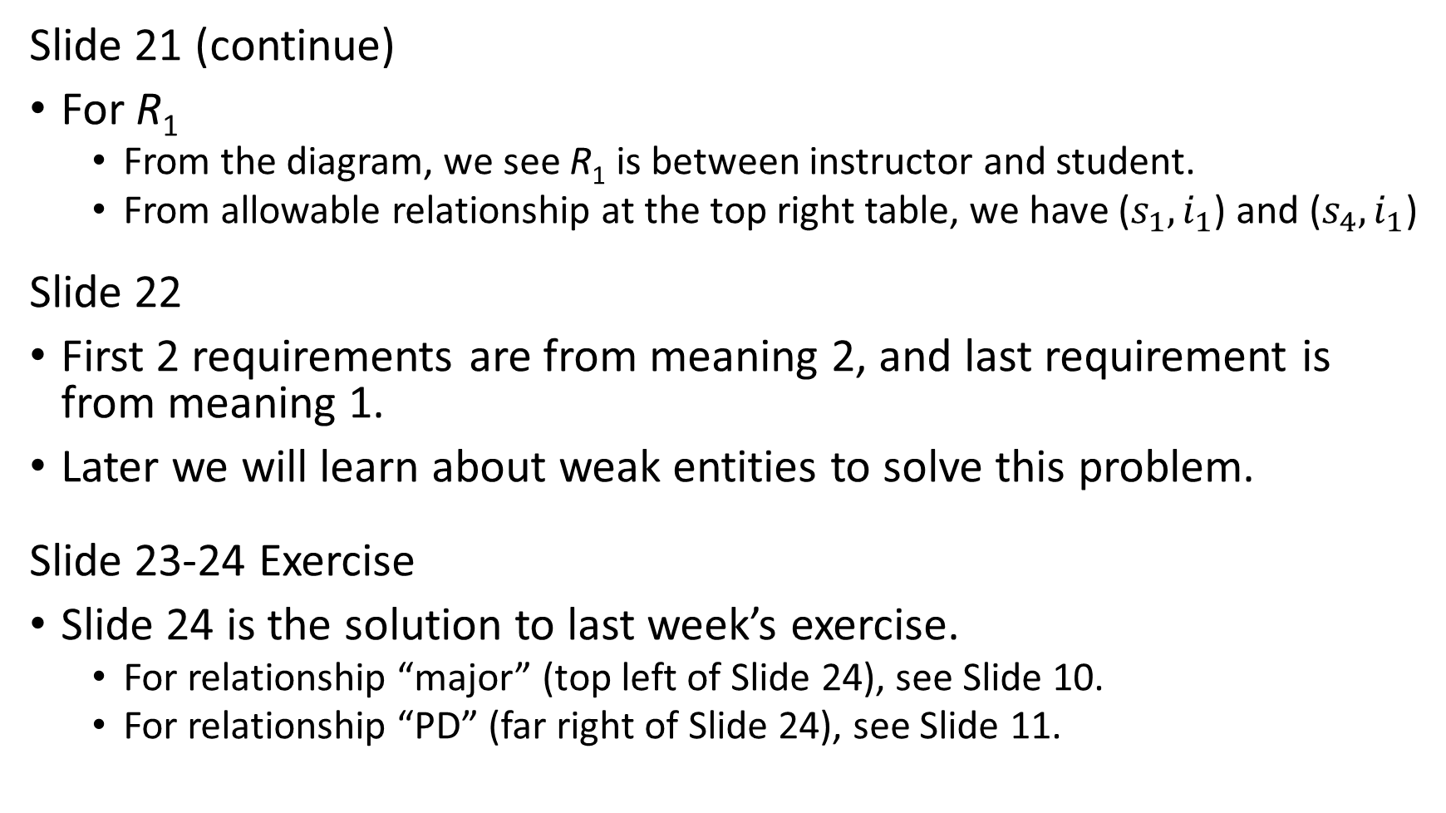
Slide 21 (continue)
For R₁
  From the diagram, we see R₁ is between instructor and student.
  From allowable relationship at the top right table, we have ($s_{1},i_{1}$) and ($s_{4},i_{1}$)
Slide 22
First 2 requirements are from meaning 2, and last requirement is from meaning 1.
Later we will learn about weak entities to solve this problem.
Slide 23-24 Exercise
Slide 24 is the solution to last week’s exercise.
  For relationship “major” (top left of Slide 24), see Slide 10.
  For relationship “PD” (far right of Slide 24), see Slide 11.

Slide 11
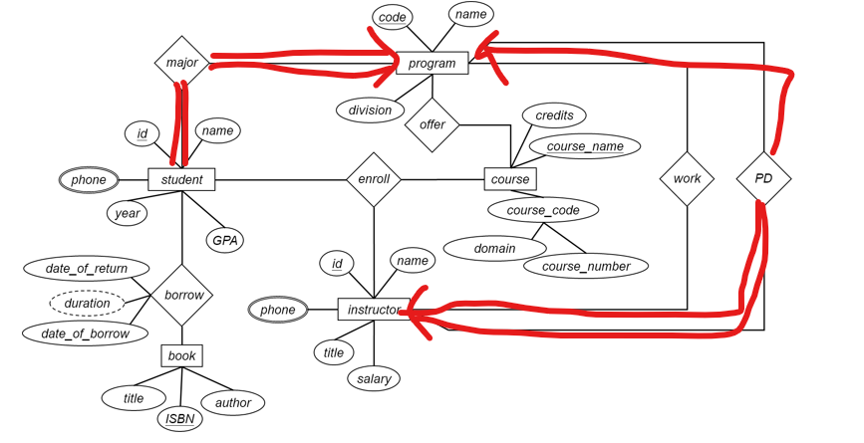
Exercises
Cardinality Constraints
Participation Constraints
For Ternary Relationship Sets
Not acceptable if you submit a drawing this bad.
You can
use computer tool to draw the diagram (see the answer), or
(2) print out the diagram in slide 29, then use pen or pencil to neatly change the figure,

Slide 12
Summary of ER Diagram Design
Modeling
Constraints
ER Model
Weak Entity
Extended
Design Issue
Design Tech
Practice
To Schema
E
entity set
R
relationship set
A
attribute
E
weak entity set
R
identifying
relationship set
A
multivalued
attribute
R
E
total
participation
many-to-many
relationship
A
derived
attribute
R
R
1..h
E
cardinality
limits
R
many-to-one
relationship
A
primary key
R
role
name
E
role
indicator
one-to-one
relationship
A
R
discriminator
ISA
ISA
ISA
total
generalization
ISA
disjoint
generalization
disjoint

Slide 13
Lab
Lecture from Lab 5 addendum.

